Slide 1
AUTOMATED MACHINE LEARNING
Π.Μ.Σ. Τεχνητής Νοημοσύνης
Μάθημα : Μηχανική Μάθηση
Διδάσκων : Βλαχάβας Ιωάννης
Παρουσίαση : Κίλης Νικόλαος

Slide 2
OUTLINE
Motivation.
Early days of Automated ML.
Larger search space and smarter optimization.
Advantages & disadvantages of Automated ML.
Open source & commercial ML tools.
Future of Automated ML.

Slide 3
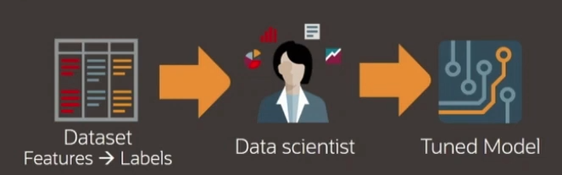
MOTIVATION
Data scientists are given a dataset and a certain task to fulfill, via a tuned model.
Large number of candidate models for each prediction task.
Each model has several hyper-parameters that need to be tuned.
Large number of features, where it is not clear which ones are relevant.
Model should generalize well to unseen data.
Laborious.
Time-consuming.
Resource intensive (high cost).

Slide 4
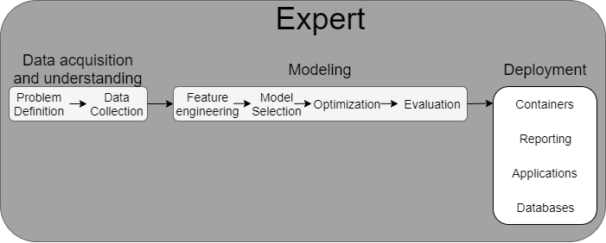
MOTIVATION
End to end Machine Learning pipeline
Modelling and Deployment automated.
Expert can focus on the problem definition, data understanding.
Results of same or greater accuracy in lesser time and computational expense.

Slide 5
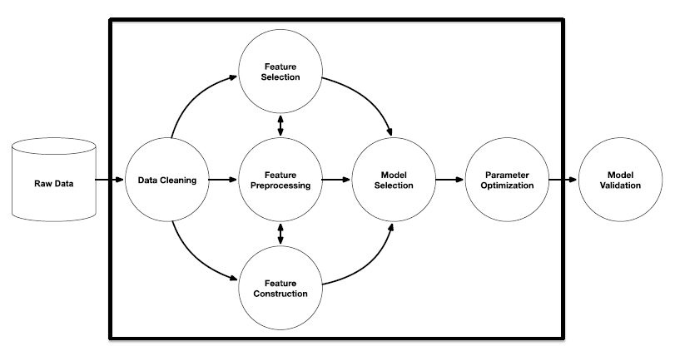
EARLY DAYS OF AUTOML
Traditional ML still requires a lot of manual programming.
Almost always after reaching Model Validation, we have to go back and repeat the whole procedure, because we are not satisfied.
Focus on parameter optimization and sometimes model selection.
Grid search and Random search were mostly used.
Nowadays, we would call these processes hyperparameter tuning and not AutoML.
AutoML strictly defined, is the entire pipeline automated.
Image source: R. Olson et. al.(2016) “Evaluation of a Tree-based Pipeline Optimization Tool for Automating Data Science.”

Slide 6
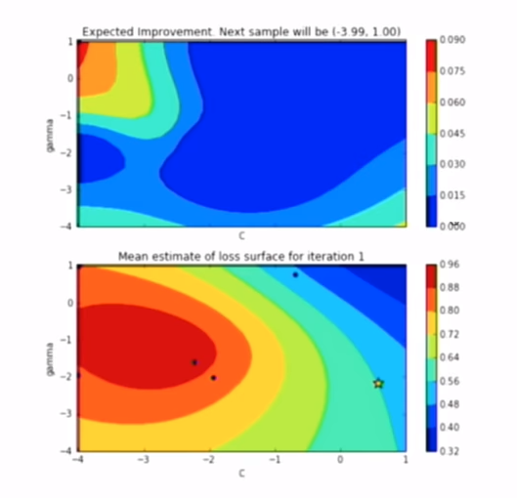
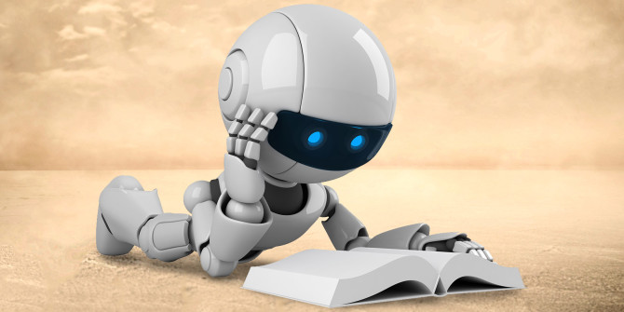
LARGER SEARCH SPACES REQUIRE SMARTER OPTIMIZATION
Meta learning.
Bayesian optimization.
Genetic programming.
Multi-armed bandit.
Image source: R. Olson & W. La Cava et. al.(2017) “Data-driven advice for applying machine learning to bioinformatics problems.”

Slide 7
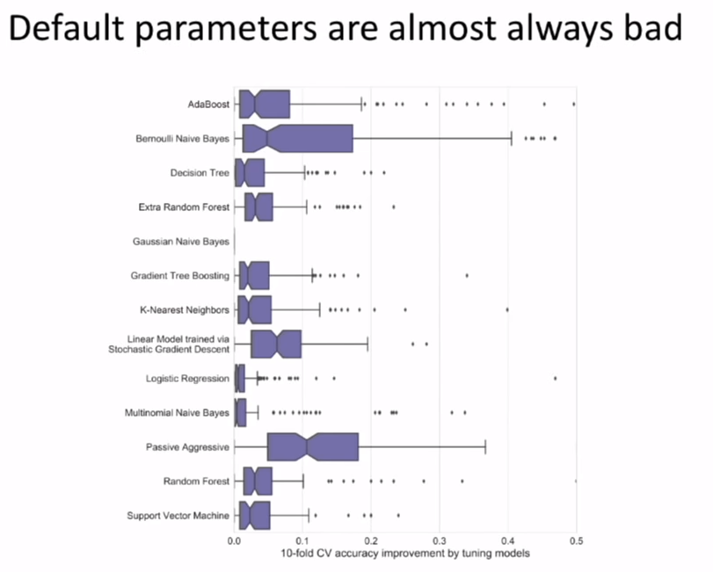
ADVANTAGES OF AUTOML-TUNING
From scikit-learn examine 13 algorithms having their default parameters and compare them to tuned versions of the same algorithms (grid search, random search etc.) and note the average improvement in performance.
Y-axis : algorithms in 165 datasets.
X-axis : distribution of improvement in performance.
Average = 5 % improvement.
Always tune and don’t rely in default parameters.
AutoML handles that for you!
Image source: R. Olson & W. La Cava et. al.(2017) “Data-driven advice for applying machine learning to bioinformatics problems.”

Slide 8
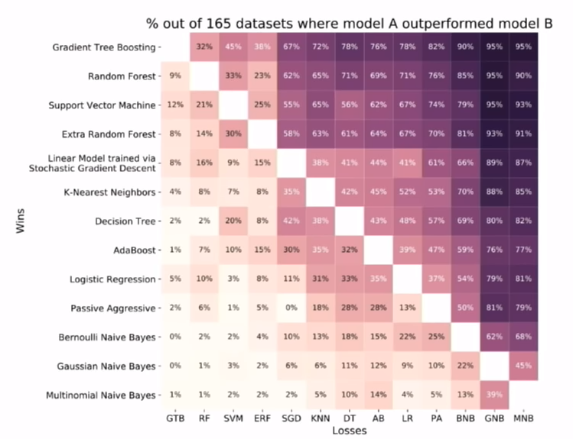
ADVANTAGES OF AUTOML-PERFORMANCE
For the same dataset, tune the algorithms and note which ones outperform the others.
What percentages of the datasets on the left algorithms outperform the bottom ones.
Note that some algorithms generally dominate the others, but in a small amount of datasets, they get outperformed. So there is no best algorithm for every problem.
Human bias towards certain algorithms may not always be correct.
AutoML handles that for you!
Image source: R. Olson & W. La Cava et. al.(2017) “Data-driven advice for applying machine learning to bioinformatics problems.”

Slide 9
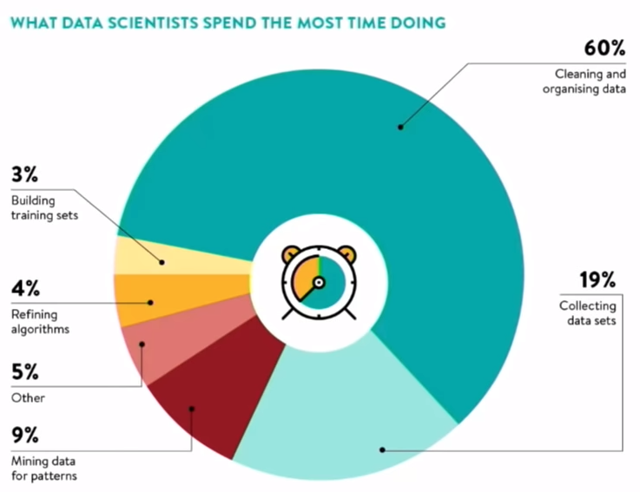
ADVANTAGES OF AUTOML-TIME SAVING
AutoML also handles that for you!
AutoML is clearly a productivity tool, which releases you from some time consuming burdens and helps you focus on the actual ML algorithm problem formulation.
Image source: visit.crowdflower.com/data-science-report.html

Slide 10
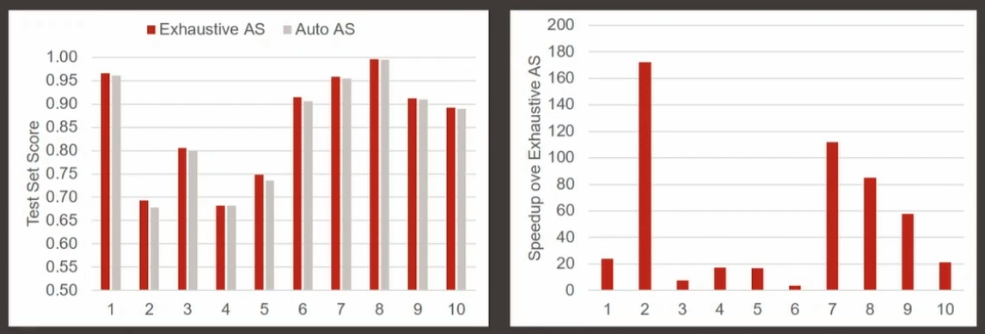
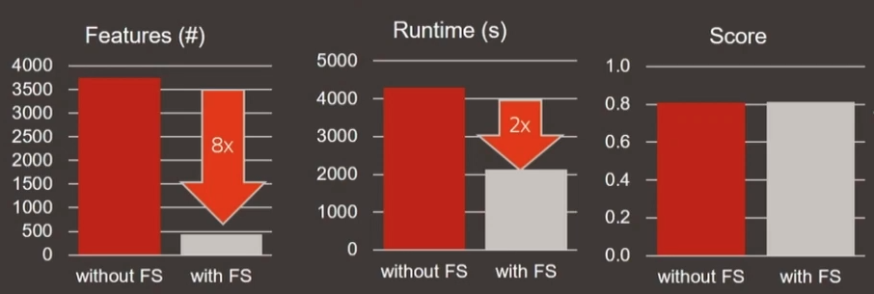
ADVANTAGES OF AUTOML-TIME SAVING
Automatic algorithm selection.
Comparison with Exhaustive search.
Faster implementation (10x-100x).
Same score.
Adaptive sampling.
More than 50% feature reduction.
Faster implementation.
Same score.

Slide 11
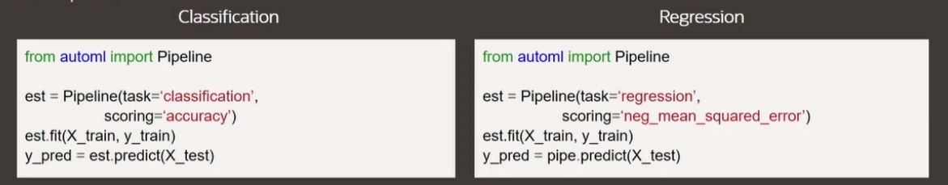

ADVANTAGES OF AUTOML-EASE OF USE
Very easy to use and in only three steps.

Slide 12
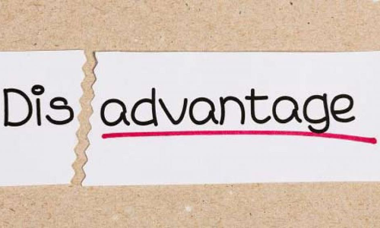
DISADVANTAGES OF AUTOML
AutoML still needs to improve in :
Speed.
Unsupervised learning.
Reinforcement learning (which are used in a time based environment scenario like a robot or a game).
-Exception in reinforcement learning:
Alpha zero
(It learned its model and hyperparameters).
Complex datatypes.
Feature engineering (choosing features requires domain knowledge).

Slide 13
OPEN SOURCE AUTOML TOOLS
Auto-sklearn [Python].
- Bayesian optimization over a fixed 3-step ML pipeline.
- github.com/automl/auto-sklearn.
Auto-Weka [Java].
- Similar to auto-sklearn, but build on top of Weka.
- github.com/automl/autoweka.
TPOT [Python].
- Genetic programming over a configurable ML pipeline.
- github.com/EpistasisLab/tpot.
H2O.ai AutoML [Java w/ Python, Scala & R APIs and web GUI].
- Basic data prep w/ mix of grid and random search over ML algorithms.
- github.com/h2oai/h2o-3.
Devol [Python].
- Deep learning architecture search via genetic programming.
- github.com/joeddav/devol.

Slide 14
COMMERCIAL AUTOML TOOLS
DataRobot.
- Web-based interface.
- Fixed search over thousands of ML pipelines.
H2O.ai Driverless AI.
- Web-based interface.
- H2O.ai AutoML + better feature construction.
Google AutoML.
- Integrated in the Google Cloud Compute platform.
- DNN architecture search.
SAS Factory Miner.
- Fixed search over a handful of ML methods.
IBM SPSS Modeler.
- Basic automated data preparation and ML modeling.

Slide 15
AUTOML IN THE NEAR FUTURE
AutoML will also handle most of the data cleaning process.
-Unstructured data → tabular data ready for analysis
-Capture & automate human approaches to data cleaning
AutoML will vastly improve Deep Learning.
-Automated DNN architecture design
-Automated preprocessing of data prior to modeling
AutoML will scale to large datasets.
-Most AutoML tools are very slow on “Big Data”
-Spark, Dask, TensorFlow, etc. will help bring AutoML to scale
-H2O AutoML & TPOT on Dask already show promise for scalability
AutoML will become human-competitive.
-Already human-competitive on several Kaggle challenges (top 10% of entries)
-Already human-competitive in DNN architecture design (Google AutoML)

Slide 16
AUTOML IN THE FUTURE
AutoML will transform the practice of data science as we know it.
-“Data Science Assistant” → Junior Data Scientist level
-Less focus on choosing the right ML workflow
-More focus on posing the right questions, collecting & curating the right data, and “thinking like a data scientist”
AutoML will become productized.
-“Siri, set an alarm for 6am” → “Siri, set an alarm for the best time for me to wake up”
-“Siri, [given my personal medical history] should I worry about this rash on my face?”
AutoML is only a small part of a greater meta-learning movement.
-Computer programming is focused on automating rote tasks
-Machine learning is focused on automating the automation of rote tasks
-Meta-learning is focused on automating the automation of automation
-i.e., enabling the machine to learn how to learn in the best way possible

Slide 17
Thank you for your attention!

